Slide 1

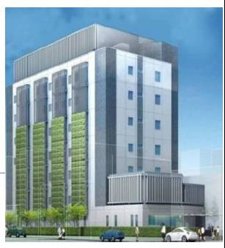
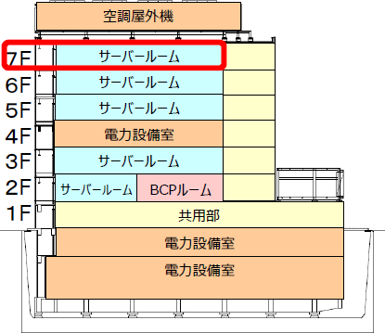
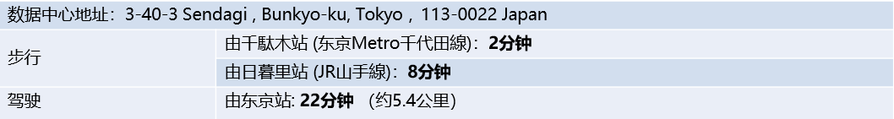
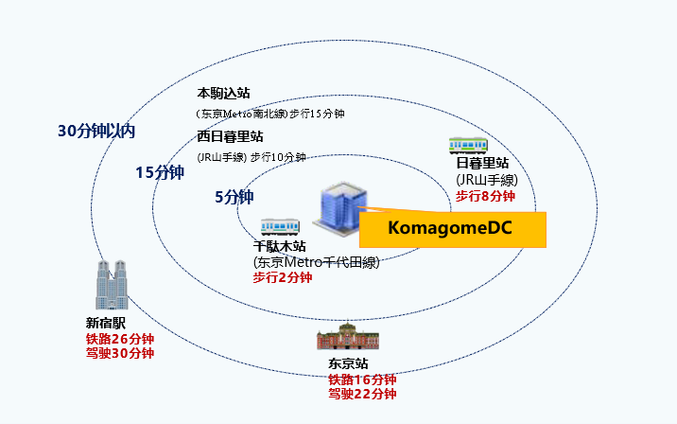
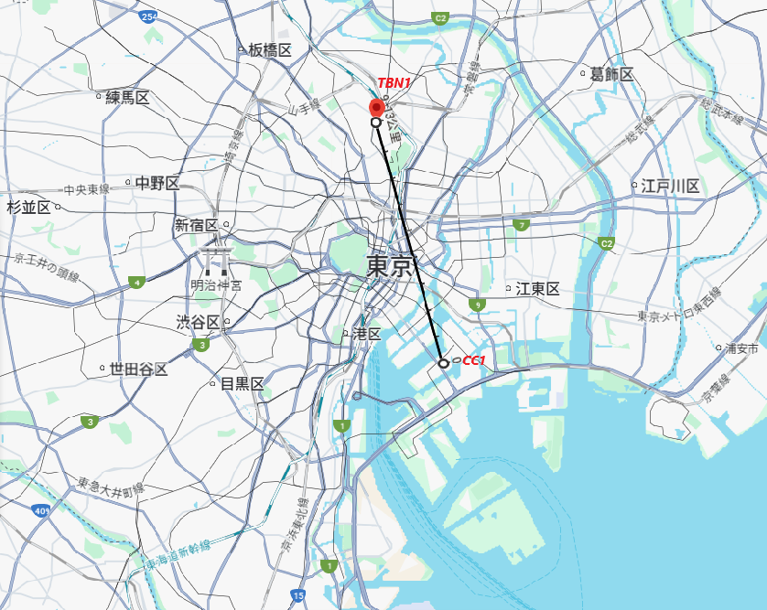
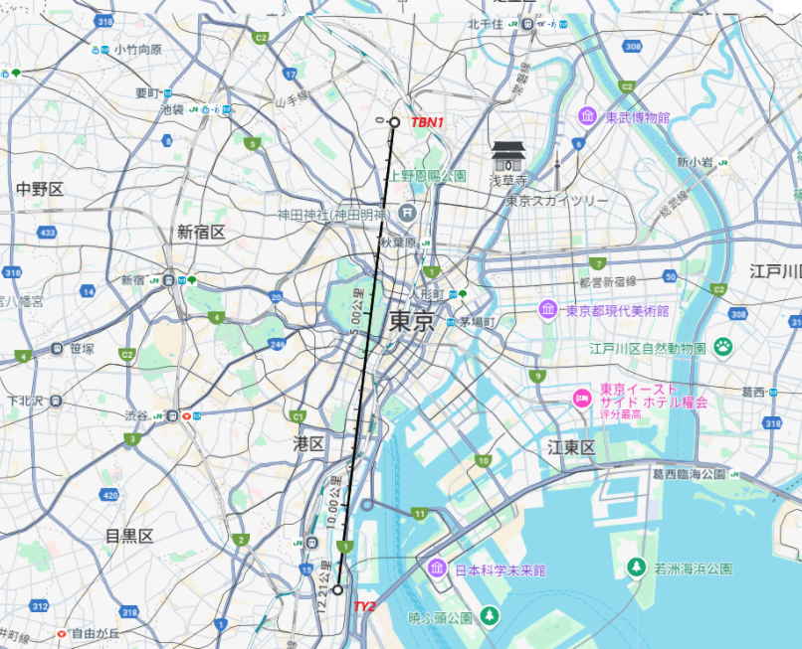
Site Overview
TBN1 is a state-of-the-art data center located on the 7th floor of NTT Komagome Building No. 2. The building is purpose-built to meet data center requirements, providing over 155 cabinets and 1.5MW of IT power.
We designed and built TBN1 to meet the latest needs of cloud, network and enterprise customers in terms of power specifications, reliability, security and ESG standards.
TBN1 is located in the core area of ​​the Yamanote Line in Tokyo, Japan, close to Tokyo Station and the main network hub of the subway. With our Cross Link interconnection service, TBN1 can easily and cost-effectively connect to core Japanese data centers such as CC1 and TY2 in EQ.
Region | Bunkyo Ward, Tokyo, Japan (Central Business District of Tokyo)
Location | Easily accessible via multiple public transport routes 1hr drive from Haneda Airport, 1hr drive from Narita Airport Located in the core area of ​​the capital
Scale | Self-built data center with 1.5MW, 155 cabinets (8kVA per cabinet) greenfield site Fully Owned & Purposely-built data center Total White Space Area: 9100 m²
Power | Max IT Load: 1.5MW
Connectivity | Fiber Entry Room: 2 MPOEs
Redundancy | N+1 UPS with Block Redundancy configuration N+1, 4500kva x 4 gas turbine generators N+2 Air-cooled module chiller
SLA | 100% availability for dual power circuit 99.99% for single power circuit
TBN1 – CC1 : 9.13km
TBN1 – TY2 : 12.21km

Slide 2
Site Overview Design Specification
FACILITIES
Power & Cooling
Power and Cooling Density
8 kVA per cabinet*
*High power density deployment available
Utility Feeders
2 utility feeders, substations: N/A
UPS Redundancy & Conﬁguration
N+1, Block Redundancy
Standby Power Redundancy &
Conﬁguration
N+1, 4500kva x 4 gas turbine generators
Cooling Redundancy & Conﬁguration N+2 Air-cooled module chiller
SPACE
Building
Ground area
4,410 m²
Total building area
9,100 m²
Data center capacity
155 cabinets, 1.5MW
Building type
7-story, purpose-built, multi-tenant
Seismic/ﬂood resistant design Intermediate layer vibration isolation structure with seismic vibration control oil damper on each floor. Built in an area with a low risk of flooding based on the government-issued hazard map.
Parking
Available
Floor
Floor load bearing capacity
1,000 kg/m2
Raised floor to ceiling height
2.7 m
Raised floor height
600 mm
Highest seismic intensity 7 earthquake design and maximum earthquake resistance.
Diesel Fuel tank
Back-up time: 48h
Designed PUE
Annual: 1.57
Security
24 × 365 onsite security and monitoring, CCTV, Card Readers, Biometrics Identification, Tailgating Prevention System
Fire Suppression
VESDA, Nitrogen gas extinguishing, Centrally controlled at Disaster Prevention Center

